Slide 1

Exercise for chapter 2

Slide 2




catalogue

Slide 3




catalogue

Slide 4
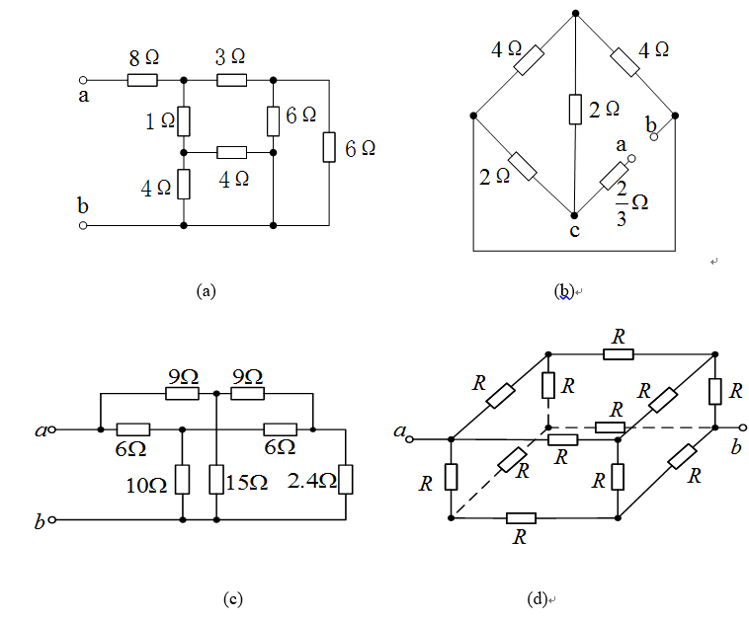
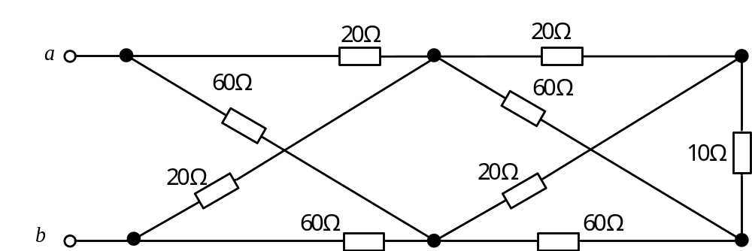
2-42 Calculate the equivalent resistance R_{ab} of each circuit shown in figures. There is R=2Ω in figure (d).
(e)

Slide 5
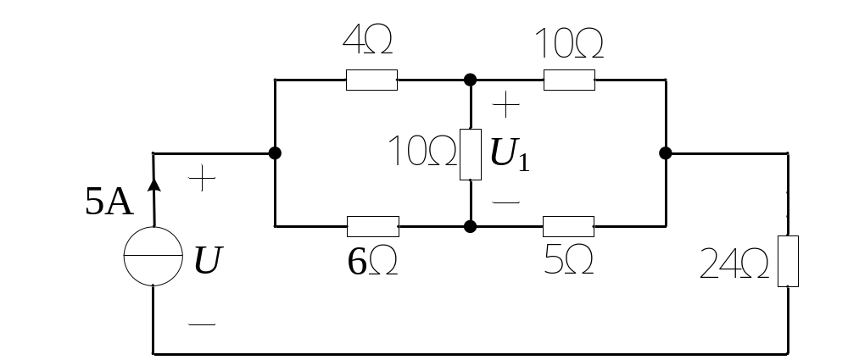
2-43 For the circuit shown in figure 2-43, calculate the current source voltage U and voltage U₁ by applying the Wye-Delta transformation.

Slide 6
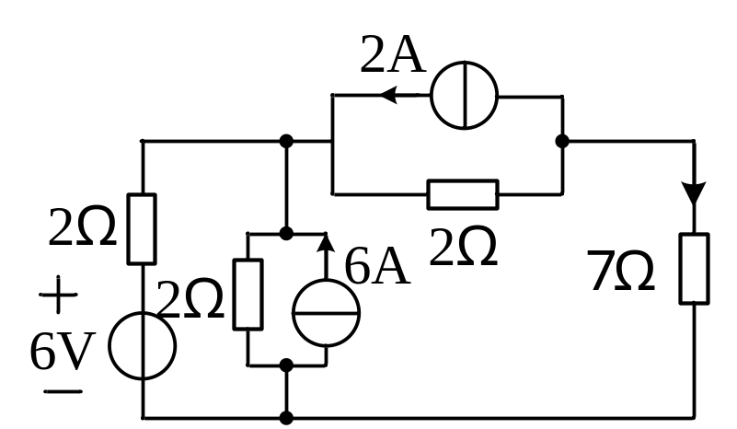
2-44 As shown in figure 2-44, find I.

Slide 7
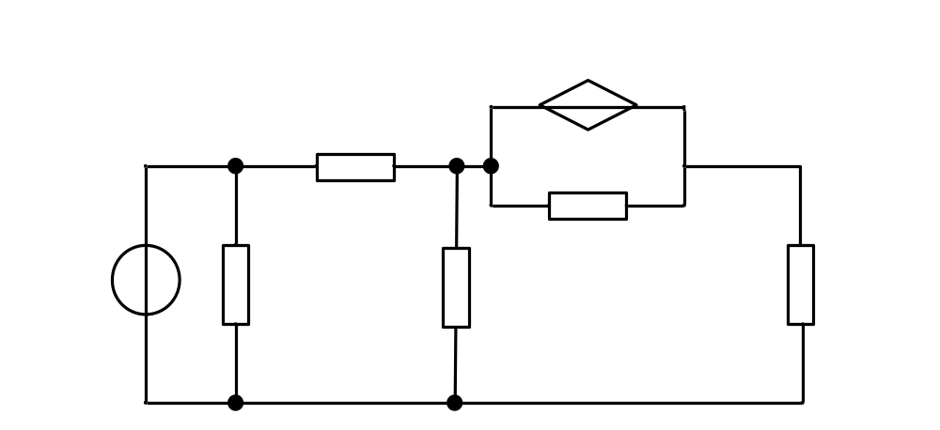
2-46 Find the power absorbed by 3.2-Ω resistor in the circuit shown in figure 2-46.

Slide 8
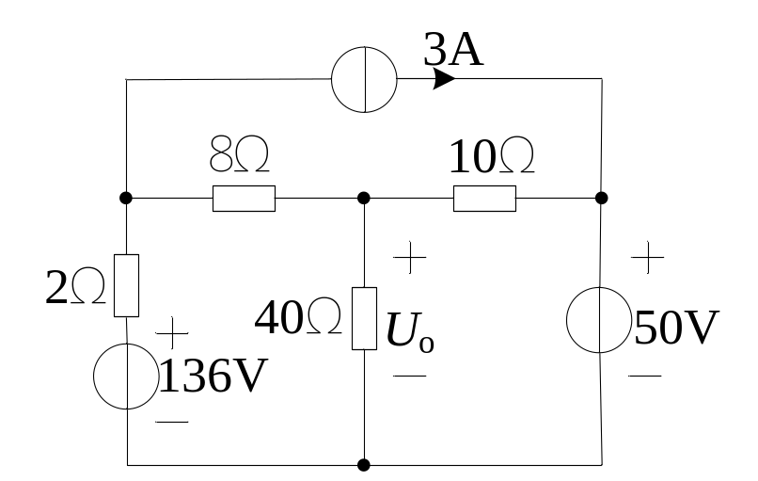
2-48 Applying mesh-current method, calculate the voltage U_{o} in the circuit shown in figure 2-48.

Slide 9
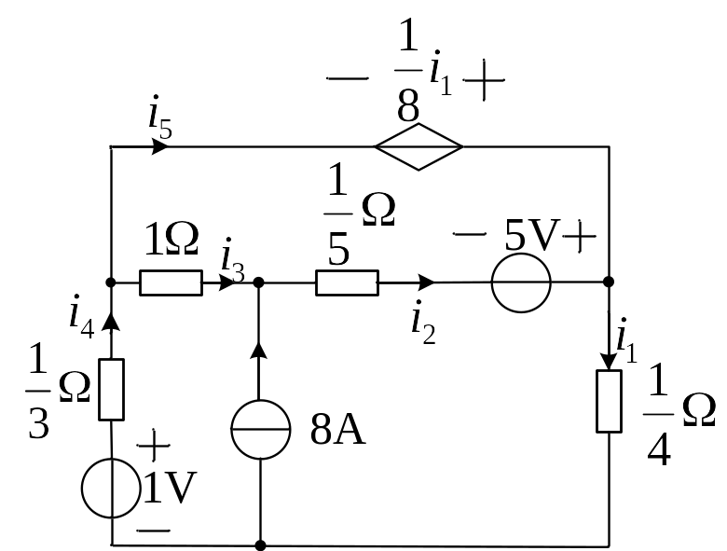
2-51Applying loop-current method, calculate all branch currents in the circuit shown in figure 2-51.

Slide 10
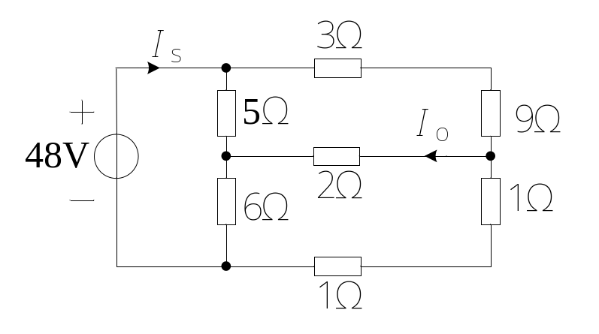
2-52 By node-voltage method, find I_{s} and I_{o}

Slide 11
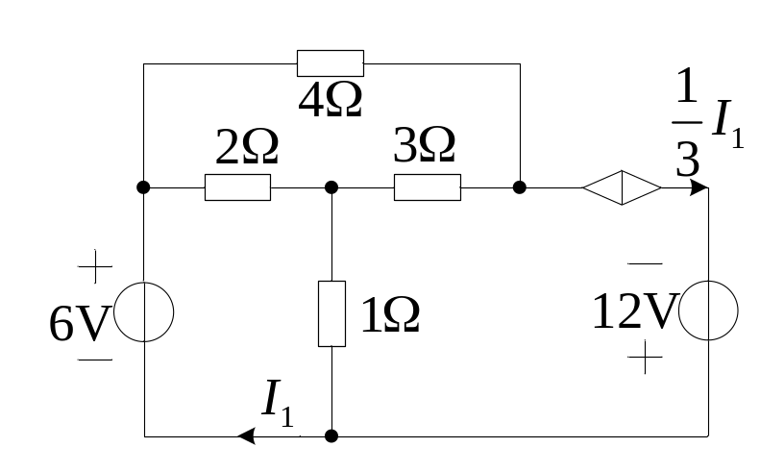
2-53 By node-voltage method, find power of each controlled source in the circuit of figure2-56.

Slide 12
Thanks!

